Slide 1


Data-Driven Storytelling:
A Movie Pitch Machine
Team 2:
Mel Collins
Janice Fong
Tanupriya Lakshmi Narayana
Josh Quintana
Melvin Torres Pereira

Slide 2

Business Objective
Role: Production House
Question: How can we use public online data to generate a compelling, data-driven movie pitches that align with fan interest.
Key Goals:
Identify trending music
Analyze fan sentiment to cast lead actors
Explore genre and storyline themes
Combine all elements into a cohesive pitch
Notes:
Content:
In a crowded entertainment landscape, standing out requires more than a great script — it requires strategic insight into what audiences crave. Our project leverages real-world, user-generated content from Reddit, Spotify, YouTube, AO3, and movie metadata to reverse-engineer audience preferences and develop a data-backed movie pitch.
Role: Production House pitching movie ideas to film studios
Question: How can we use public online data to generate a compelling, emotionally resonant movie pitch that aligns with current trends in music, fan interest, and casting preferences?
Key Goals:
Identify trending music and emotional tone to guide soundtrack and story arc
Analyze fan casting sentiment to inform lead actors
Explore genre and storyline themes favored across fan forums
Combine all elements into a cohesive pitch that reflects audience demand
We integrated sentiment, topics, trends, and casting insights across platforms to create a compelling and emotionally resonant film idea grounded in what people already love.

Slide 3

Our Process
Planning & Organizing:
Created standardized naming systems, file management, and notebook scripts.
Weekly check-ins to align progress and integrate workflows across areas.
Data Identification
Determine what data we need to create a compelling, data-driven movie pitch.
Identified key drivers of movie success: music, casting, genre, story.
Defined team data roles based on interest areas (music = Mel, casting = Tanu, genre = Josh, storyline = Janice, budget = Melvin).
Data Gathering:
Used APIs (YouTube, Reddit, Spotify) and web scraping (AO3, The-Numbers) to gather unstructured, real-time content.
Translated multilingual comments (YouTube) and storylines (AO3)
Data Processing:
Cleaned data for text and encoding issues (e.g., emojis, accents, missing values).
Used modular Python scripts to streamline fuzzy matching, sentiment tagging, and topic modeling across sources.
Data Analysis & Output:
ChatGPT and Custom Analysis UI built with Gemini
Notes:
1. Data Identification
We first determined the core components of a compelling movie pitch—genre, storyline, actors, budget, and soundtrack—and identified which data sources could inform each. These included YouTube, Spotify, Reddit, AO3 (fanfiction), and The-Numbers.com.
2. Data Collection
Each teammate scraped or queried different platforms:
Music Trends (Mel): YouTube API, Spotify API, and comment data
Storylines (Janice): AO3 and Reddit story summaries
Fan Feedback & Posters (Josh): Reddit comments + fan posters
Actor Sentiment (Tanu): Reddit fancast subreddits
Budget & History (Melvin): The-Numbers.com for past film data
3. Data Processing
We cleaned, translated, and aligned the data:
Translations with deep_translator and Facebook’s multilingual model
Text normalization using spaCy, stopwords, and punctuation filters
Matched music titles across platforms using RapidFuzz
Extracted metadata and removed noise from unstructured text
4. Data Analysis
We used advanced NLP and clustering tools to extract meaningful insights:
BERTopic & LDA for storyline and genre modeling
Sentiment analysis to understand emotional tone (RoBERTa model)
Clustering (UMAP, KMeans) to find actor and story trends
Music relevance scoring and alignment with emotional themes
Budget mapping based on similar historical movie profiles
The result: five well-reasoned, original movie pitches rooted in actual data trends, with realistic budgets, emotionally aligned soundtracks, and fan-approved casting. Each pitch was supported by visual mockups and detailed metadata, helping us bridge creative storytelling with data science rigor.

Slide 4









Data Identification: Determine what data we need to create a compelling, data-driven movie pitch.
Music
Genre
Storyline
Actors
Budget
Notes:
Genres: Targeted Reddit discussions and movie posters to understand audience perception and visual appeal.
Storyline: Focused on fanfiction storylines as a proxy for public imagination and emotional themes.
Music: Identified music trends as a key influence on audience sentiment and mood-setting for films.
Actors: Focused on fan-casting comments to explore actor popularity and genre fit.
Budgets & Historical Movie Data: Targeted historical movie budget and cast data to anchor the project in real-world feasibility.

Slide 5







Data Gathering: Gather data from relevant platforms using APIs and scraping tools.
Genres:
Storyline:
Music:
Actors:
Budgets & Historical Movie Data:
Notes:
Music: Collected top YouTube music videos + comments, matched them with Spotify metadata via API and fuzzy matching.
Storyline: Scraped AO3 (Archive of Our Own) and Reddit for story summaries, titles, and user sentiment.
Genres: Scraped Reddit posts/comments from multiple subreddits and downloaded movie posters from Google Images.
Actors: Extracted Reddit fancast posts and filtered actor-specific discussions across genres.
Budgets & Historical Movie Data: Scraped The-Numbers.com for budgets, box office data, and cast images from thousands of films.

Slide 6

Data Processing: Extract insights to inform film pitches across 5 dimensions: genre, storyline, actors, budget, and music.
Music: Built soundtrack suggestions using comment sentiment, artist metadata, and genre correlation from YouTube + Spotify.
Storyline: Mined fanfiction and subreddit summaries for high-frequency themes using BERT, LDA, sentiment analysis.
Genre: Identified popular and emerging genres (e.g., AI dystopia, Atlantis adventure, coming-of-age romance) via Reddit and AO3 trends.
Actors: Clustered Reddit fan-casting comments by genre and actor type to choose stars with high emotional and narrative alignment.
Budget: Matched proposed storylines with similar historical movie budgets from The_Numbers.com.
Notes:
To guide data-driven film pitches, we focused on five core creative dimensions: genre, storyline, actors, budget, and music.
Music: Mined YouTube comments and matched sentiment with Spotify metadata to suggest fitting soundtracks.This gave us emotionally aligned and audience-relevant track suggestions.
Storyline: We mined fanfiction platforms and subreddit summaries using NLP techniques like BERT embeddings and LDA topic modeling to surface recurring high-interest themes and emotional arcs.
Genre: We tracked trending and emerging genres across Reddit and Archive of Our Own (AO3), identifying patterns like AI dystopias, Atlantis-themed adventures, and nostalgic coming-of-age romances.
Actors: We scraped and clustered Reddit fan-casting comments, sorting by genre and character archetypes. This helped surface actors that resonated both emotionally and narratively with target audiences.
Budget: We took proposed storylines and compared them to similar films in The_Numbers.com database. This helped us ground pitches with realistic budget expectations based on historical precedent.

Slide 7

Data Analysis & Output: Clean and prepare data for analysis.
Standard steps across team:
Removed duplicates, emojis, accents, and special characters.
Translated non-English content using models like deep_translator and m2m100.
Normalized text for NLP (e.g., lemmatization, stopword removal).
Music: Aligned YouTube titles with Spotify tracks using RapidFuzz; cleaned comment data for sentiment analysis using spaCy.
Storyline & Genre: Used BERT and LDA to extract major story and theme clusters; cleaned long-form narrative text.
Actors: Applied LDA and BERT to Reddit fan-casting data, visualized with UMAP.
Budgets & Historical Data: Parsed HTML for cast and earnings tables; extracted and saved profile images.
Notes:
Before analysis, we performed standard text cleaning across all datasets:
This included removing duplicates, emojis, accents, and non-ASCII characters.
We translated non-English content using tools like deep_translator and Facebook’s m2m100 multilingual model.
Text was normalized for NLP through lemmatization and stopword removal to improve model performance.
Music: Synced YouTube titles with Spotify tracks using fuzzy matching; analyzed comments for sentiment.
Storyline & Genre: Cleaned and clustered text using BERT and LDA to extract major story themes.
Actors: Applied topic modeling to Reddit fan-casts and visualized with UMAP.
Budget: Scraped cast and earnings data; pulled images for use in pitch visuals.

Slide 8
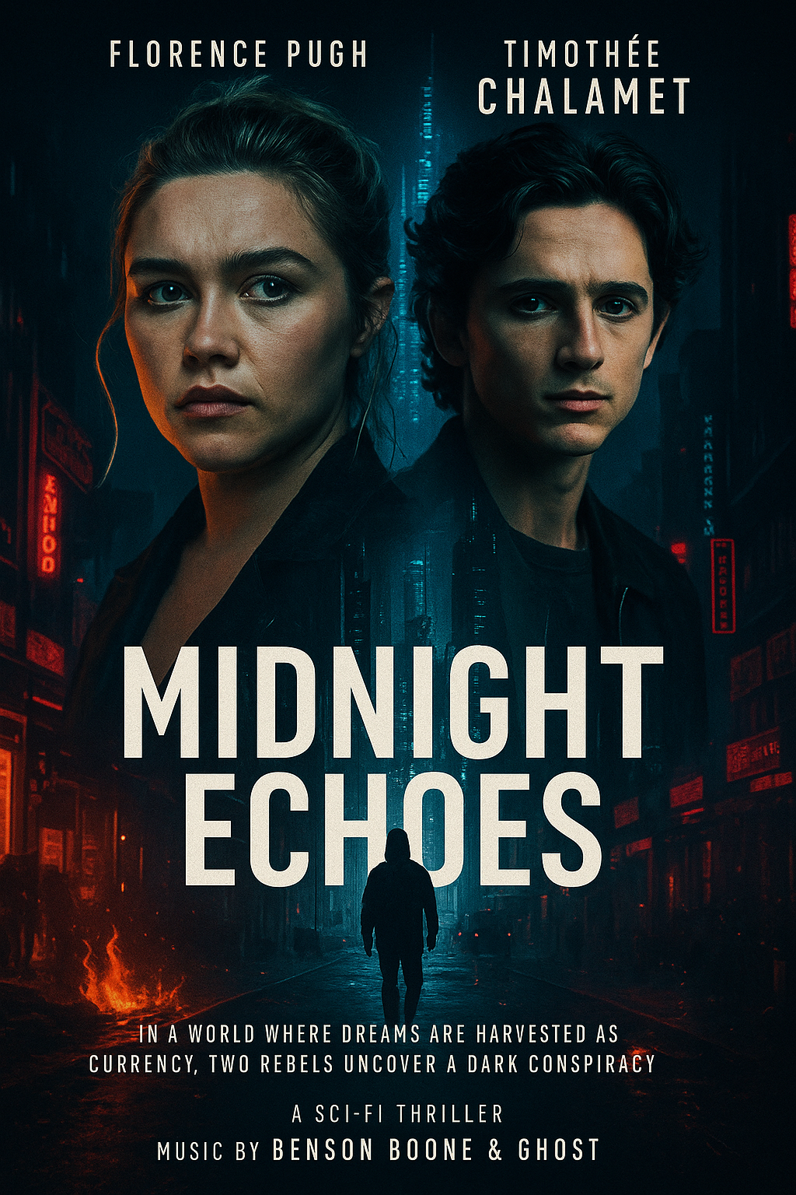

Midnight Echoes
Genre: Sci-Fi Thriller
Storyline: In a near-future metropolis where dreams are harvested as currency, an underground hacker (played by Florence Pugh) and a rogue AI specialist (played by Timothée Chalamet) uncover a conspiracy to erase human consciousness (based on fanfiction and BERTopic analysis).
Actor Picks: Florence Pugh, Timothée Chalamet
Soundtrack: A dark electronic score featuring Benson Boone and Ghost
Budget: ~$50 million, similar to mid-budget sci-fi hits
Special Angle: Capitalizes on trending “AI + dystopia” themes and strong fanfiction interest in futuristic betrayal and survival.
Notes:
Content:
Outcomes:
Merged datasets of songs, actors, and genres
Extracted themes and character tropes from fanfiction
Identified genre trends and mapped them to budget constraints
Generated three finalized, trend-backed movie pitch ideas We integrated sentiment, topics, trends, and casting insights across platforms to create a compelling and emotionally resonant film idea grounded in what people already love.
Now Let’s look at the key outcomes and exactly how we used this information to create movies that audiences will love
we merged multiple datasets—songs, actors, and genres—to clearly see what's popular now. Extracted strong story themes and character tropes directly from fanfiction and Clearly identified genre popularity and matched these with realistic budget constraints. We carefully matched these Fan-casting insights helped us select popular actors like Florence Pugh and Timothée Chalamet trends to realistic movie budgets." Connect to your Movie Pitch: "Using this data, we created our first pitch, 'Midnight Echoes,' a sci-fi thriller. We chose music based on emotional reactions from Spotify,Reddit and YouTube comments. Fanfiction analysis (using NLP) informed our gripping storyline involving AI and human survival. Fan-casting insights helped us select popular actors like Florence Pugh and Timothée Chalamet.
Quickly Summarize: "Overall, this pitch reflects exactly what fans already love—futuristic, emotional stories with relatable actors and engaging music."

Slide 9
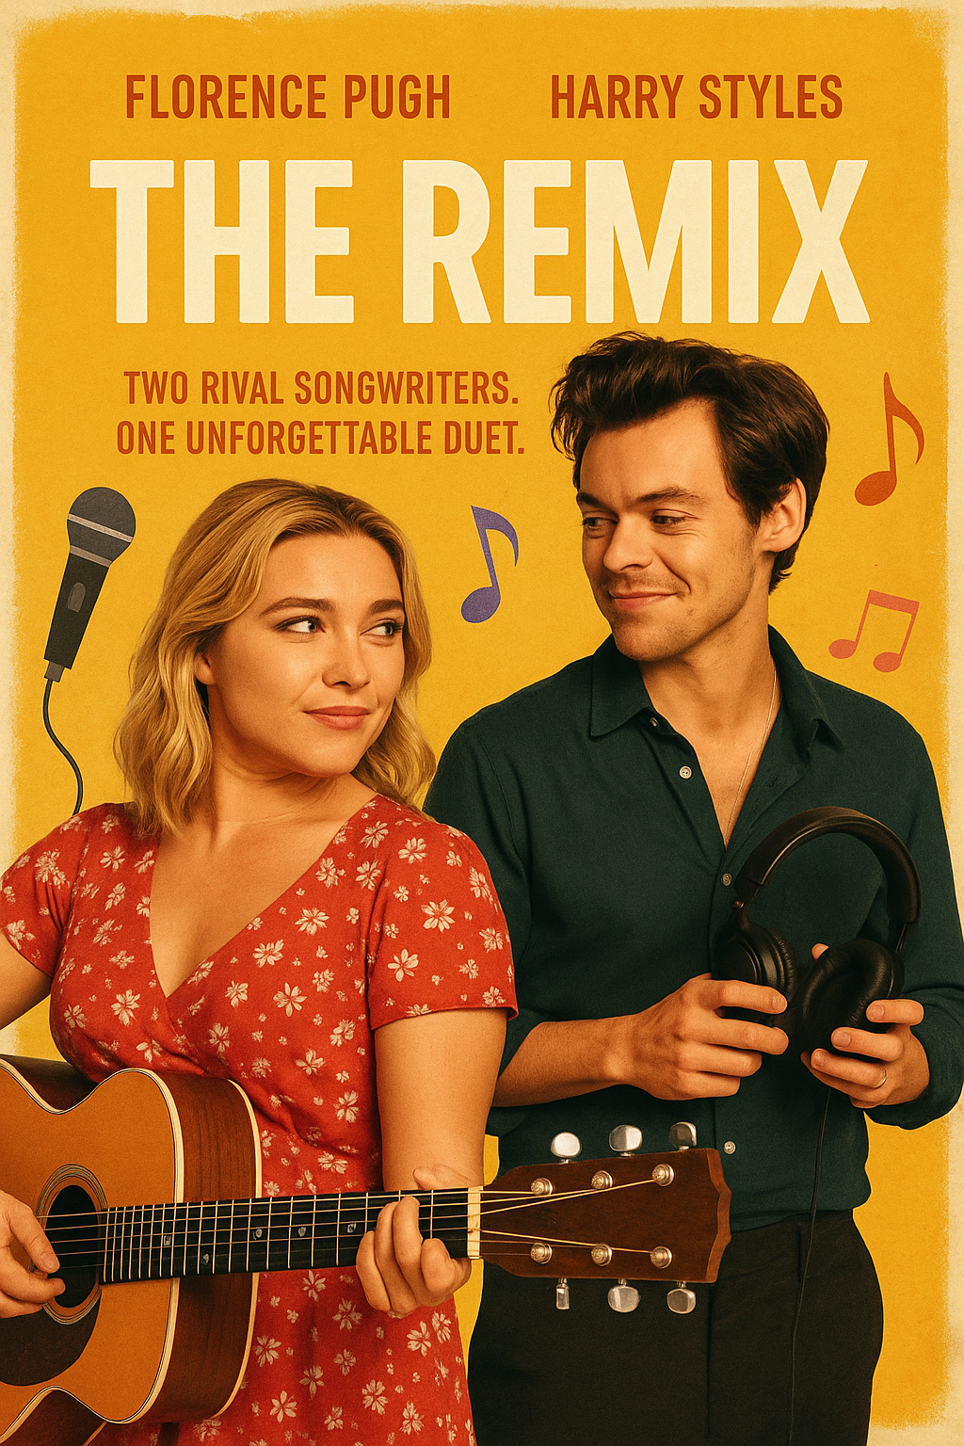
The Remix
Genre: Romantic Comedy/Musical
Storyline: Two rival songwriters—a chart-topping pop sensation (Harry Styles) and a fiercely independent indie artist (Florence Pugh)—are forced to collaborate under a major label deal to produce the headline anthem for the Aurora Music Festival. As they clash over lyrics, melodies, and creative pride, an unlikely bond forms—blending their musical worlds and redefining what success (and love) means.
Top Actors: Florence Pugh, Harry Styles
Soundtrack: “TOUCHÉ” – GIMS & KEBLACK (danceable, mainstream French pop with crossover appeal) “La Última Carta” – Río Roma & Ha-Ash — a heartfelt bilingual ballad that could inspire the climactic final performance.
Budget: 30–40 million, aligned with mid-range musical rom-coms (like La La Land or Yesterday)
Special Angle: Leverages trending fanfiction tropes (rivals to lovers, music collabs) while merging global musical influences (Spanish-language ballads, French pop, indie rock).
Notes:
Content:
Outcomes:
Merged datasets of songs, actors, and genres
Extracted themes and character tropes from fanfiction
Identified genre trends and mapped them to budget constraints
Generated three finalized, trend-backed movie pitch ideas We integrated sentiment, topics, trends, and casting insights across platforms to create a compelling and emotionally resonant film idea grounded in what people already love.
Outcomes:
Successfully merged data sets covering trending songs, fan-casted actors, and popular genres.
Extracted clear romantic-comedy themes from fanfiction platforms.
Identified global music trends and matched these to feasible budgets.
This finalized pitch 'The Remix,' deeply aligned with fan preferences.
Integration:
Analyzed global music trends from Spotify and YouTube to create an appealing soundtrack mix.
Utilized fanfiction data (BERT/LDA) to shape a relatable and engaging storyline: rivals turning into lovers.
Casting preferences guided us toward selecting actors Florence Pugh and Harry Styles, due to their strong audience appeal.
"'The Remix' demonstrates how data integration can create a fun, culturally relevant, and emotionally engaging movie pitch."

Slide 10

Verde
Genre: Romance /Coming of AgeDrama
Storyline: A young botanist (played by Amandla Stenberg) escapes her corporate life to revive her late grandfather’s forgotten vineyard in rural Mexico. There, she battles family secrets and rediscovers her passion (from fanfiction trends + Reddit + BERTopic genre cluster).
Actor Picks: Amandla Stenberg, Christian Nodal (new acting debut — music star crossover!)
Soundtrack: Emotional, Spanish-language ballads by Christian Nodal and Angela Aguilar, blending with indie acoustic tracks.
Budget Range: ~$15–20 million (lower budget, character-driven drama — aligned with budget files).
Special Angle: International crossover appeal (U.S./Mexico bilingual) and high streaming potential; fits “slow burn drama” genre seeing fanfiction buzz.

Slide 11

Reflections and Lessons Learned
What we learned
What would be change
API integration and multilingual sentiment extraction
Large-scale text processing and clustering
Short Reddit comments made BERT harder to apply
Created resume-safe scraping logic
Would improve fuzzy matching + add TikTok virality if time allowed
Reddit is noisy; would use YouTube/TikTok for more curated commentary
Would explore better Named Entity Recognition (NER) next time
Would enhance visuals & merge with IMDb
BERT required too much compute; next time: smaller batches

Slide 12
Q&A

Slide 13
Thank You

Slide 14
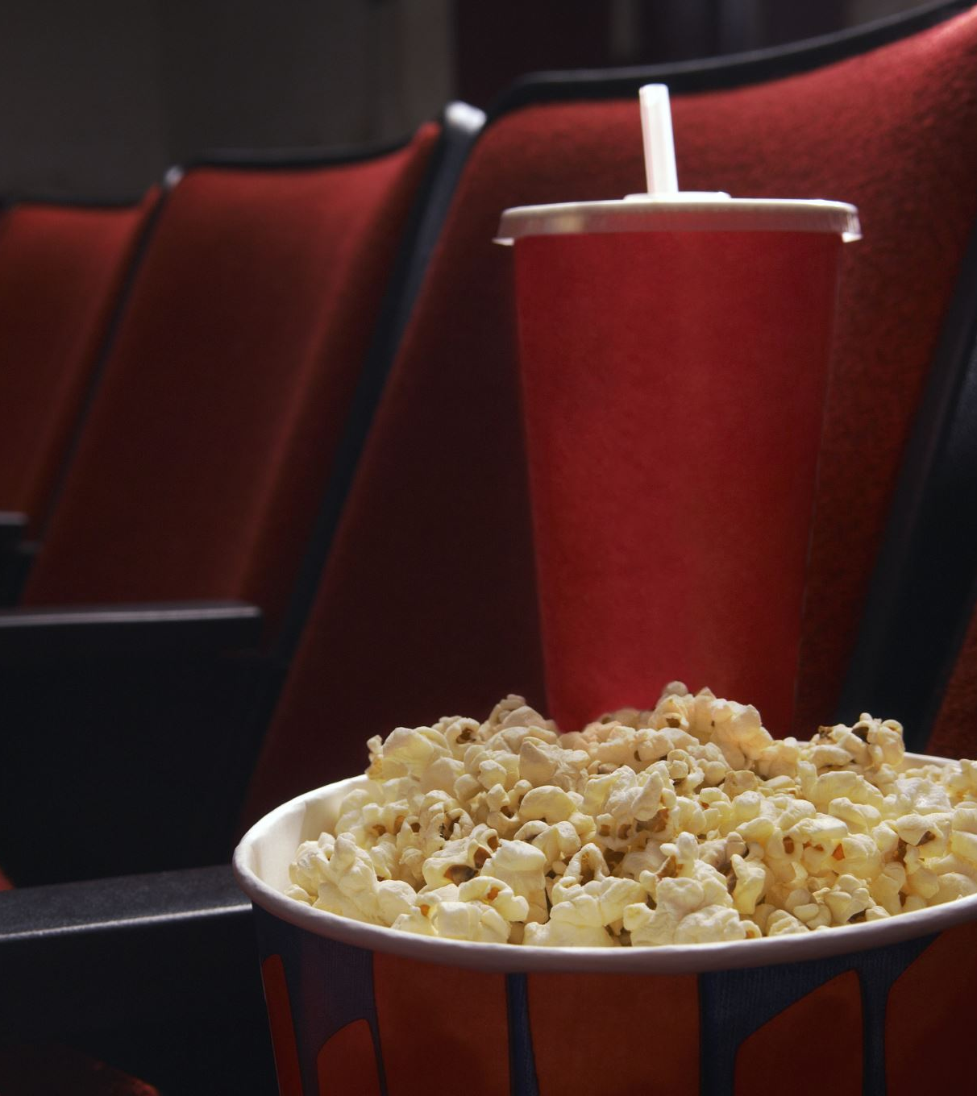
Appendix
More Movie Outputs

Slide 15
Appendix: Data Gathering & Analysis Techniques Libraries Used (27)
Library / Tool | Purpose / Function |  | Library / Tool | Purpose / Function
pandas | Data manipulation, reading/writing CSVs, cleaning datasets |  | praw | Reddit API (RedditWrapper) for subreddit scraping
numpy | Numerical operations (implied in some scripts but also common with sklearn) |  | beautifulsoup4 (bs4) | Web scraping AO3 fanfiction site (HTML parsing)
matplotlib | Data visualization (plots, histograms, etc.) |  | deep-translator | Translate YouTube and AO3 comments into English
seaborn | Advanced data visualization (used in topic cluster visualizations) |  | transformers | Used pretrained BERT models for topic modeling and sentiment
wordcloud | Generated word clouds to visualize frequent terms in text data |  | sentence-transformers | Created embeddings for clustering (with BERT)
spacy | NLP processing: tokenization, lemmatization, POS tagging |  | umap-learn | Dimensionality reduction for topic visualization (especially BERT)
scikit-learn | KMeans clustering, preprocessing, vectorization |  | gensim | LDA topic modeling (traditional unsupervised method)
rapidfuzz | Fuzzy matching between YouTube and Spotify track titles |  | stanza | POS tagging and lemmatization (in Janice’s AO3 NLP pipeline)
re (regex) | Text cleaning: pattern removal, normalization |  | fasttext | Language detection model used before translation
time | Delay execution to manage API rate limits |  | ChatGPT / Grok AI | Assisted in code development, debugging, and conceptual modeling
os | File path handling and directory creation |  | pyLDAvis | Visualizing LDA topics interactively
csv | Reading and writing raw CSV files |  | requests | HTTP library for scraping sites like The-Numbers.com
spotipy | Spotify API access for music metadata |  | PIL / imageio | Image downloading and saving for actor profiles
google-api-python-client | YouTube API access for video data, comments, etc.

Slide 16
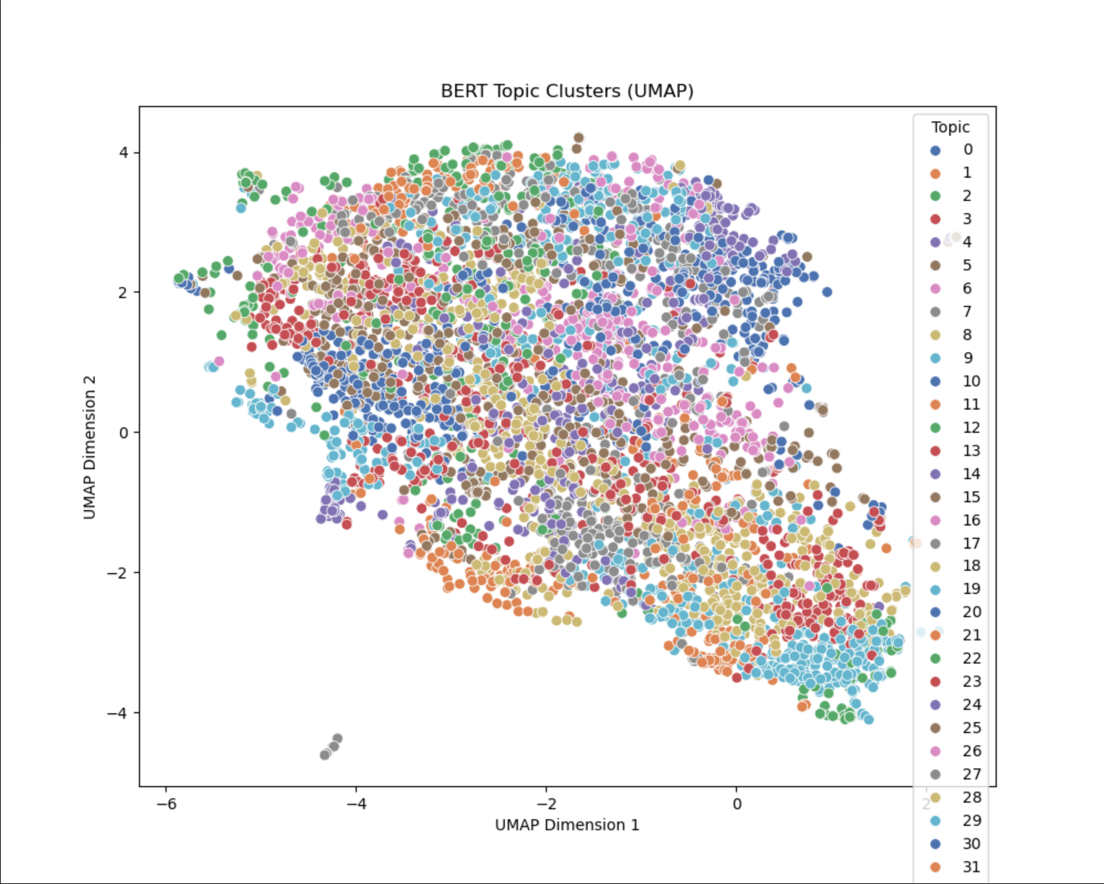
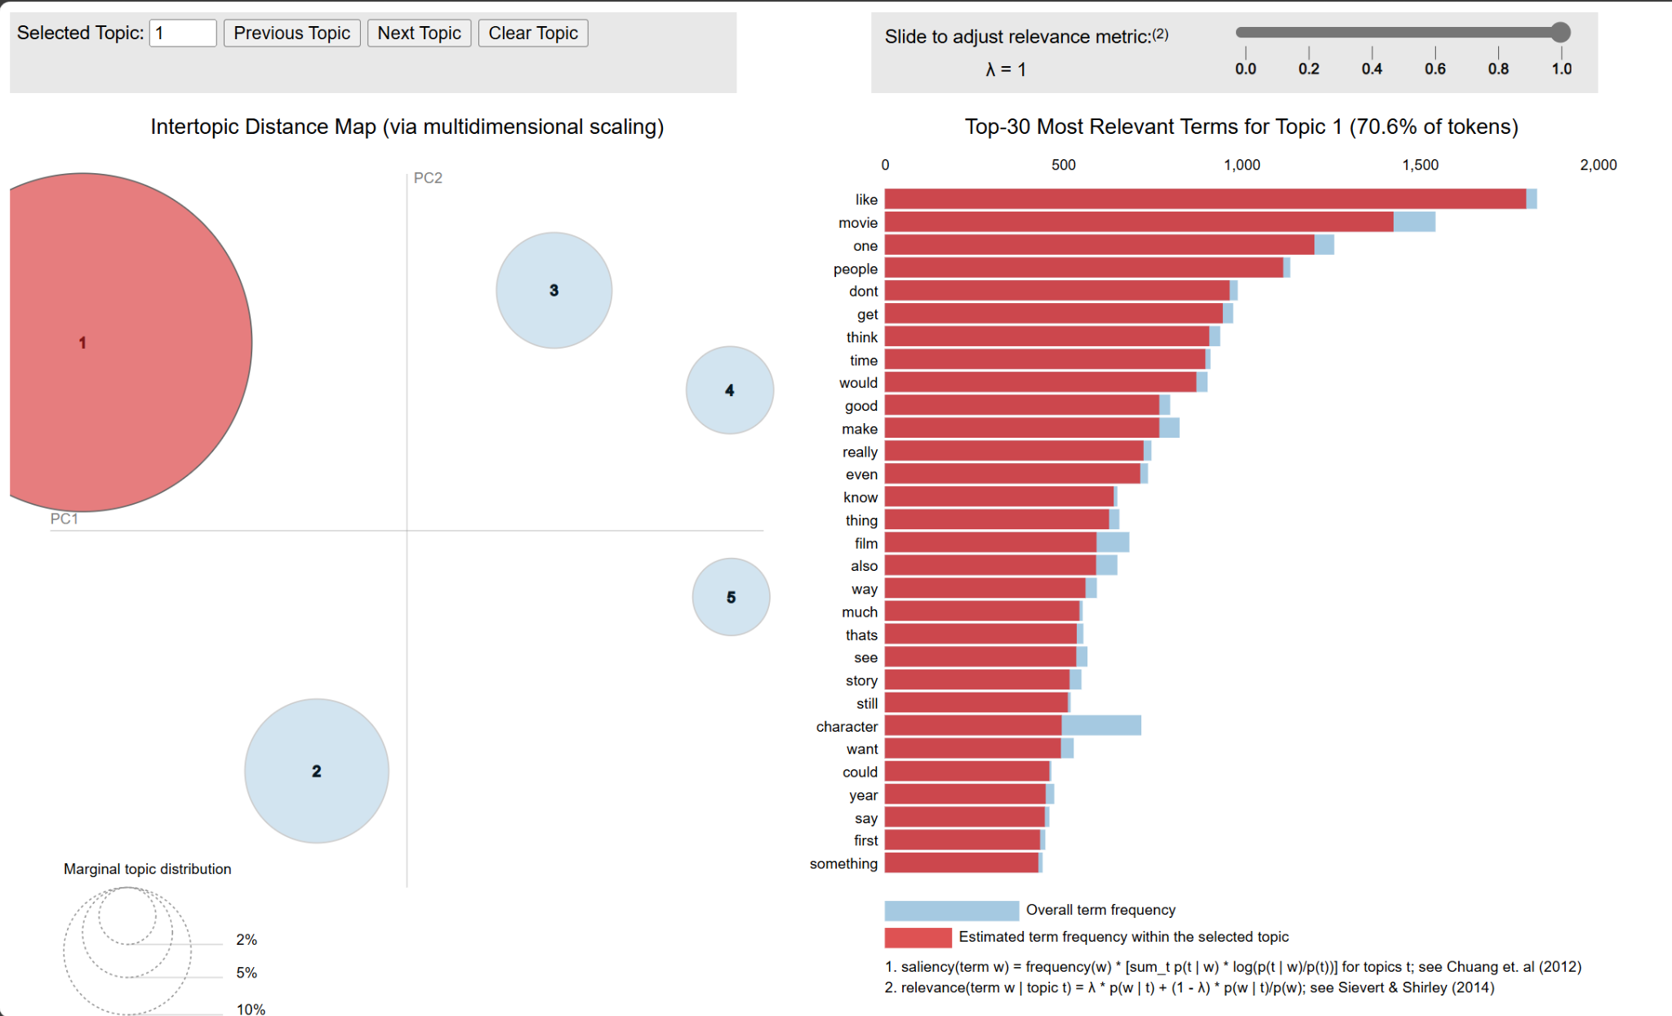
BERT Visualization Examples
Notes:
UMAP of Storylines and LDA of Genre

Slide 17
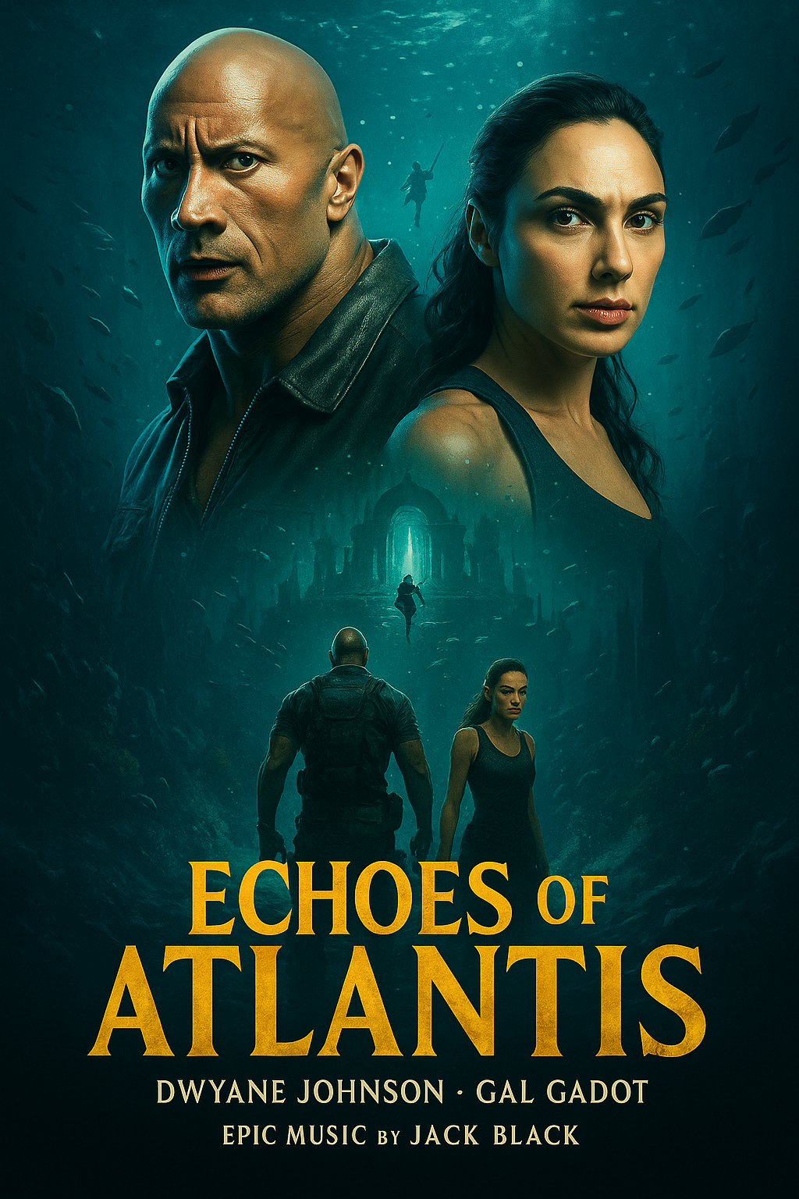
Echoes of Atlantis
Genre: Action Adventure / Mythical Comedy
Storyline: A skeptical archaeologist (played by Dwayne Johnson) and a historian (played by Gal Gadot) must navigate a deadly underwater labyrinth to find the real city of Atlantis — while being hunted by a global corporation (based on adventure clusters and fanfiction themes)
Actor Picks: Dwayne Johnson, Gal Gadot
Soundtrack: Epic orchestral scores blended with dark pop — featuring Jack Black’s rock soundtrack piece (“Steve’s Lava Chicken”)
Budget Range: ~$150 million blockbuster budget (based on similar high-end action movies).
Why: Capitalizes on enduring Atlantis mythology + adventure genre revival (fanfiction trends + fantasy story cluster).

